Slide 1



Infosys Springboard Virtual Internship 6.0
Food Trends Understanding Using Customer Preferences
NAME:HARINI M
MENTOR NAME :NITHYA SREE
Notes:
1

Slide 2

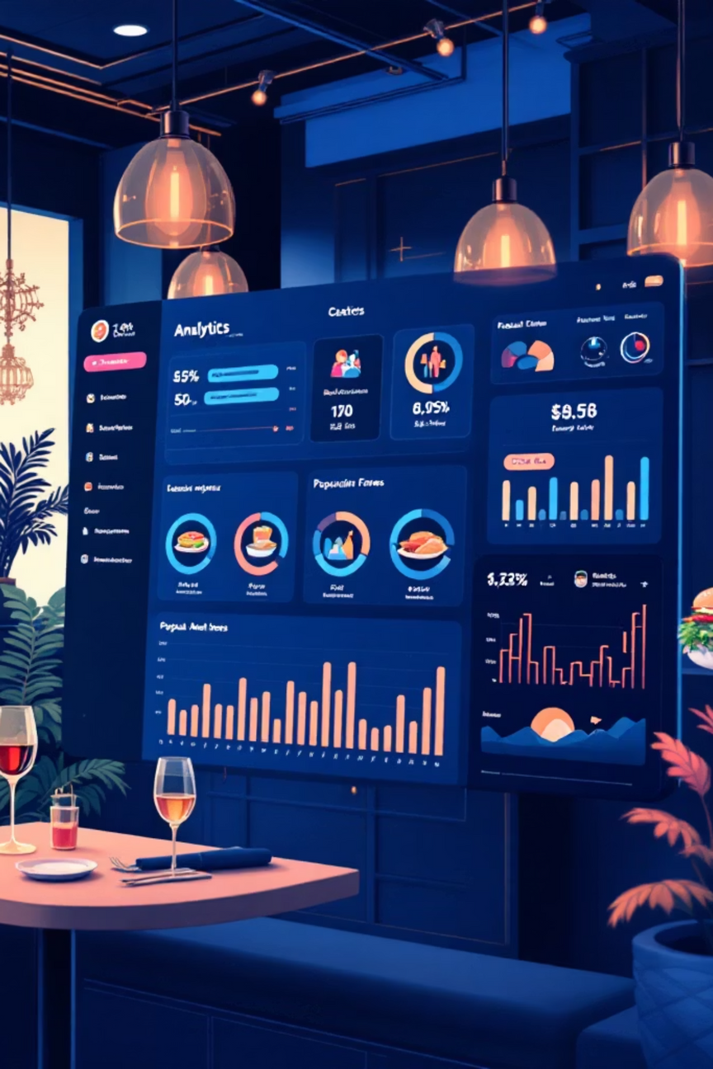
OBJECTIVE
Transforming Restaurant Data Into Strategic Insights
This project analyzes restaurant data to understand customer engagement, rating reliability, cuisine demand, pricing behavior, and service availability using Power BI dashboards. The goal is to transform raw restaurant information into meaningful insights that reveal performance patterns, customer participation trends, and strategic opportunities across global markets.
By combining data preprocessing, visualization, and analytical logic, the project supports informed decision-making and effective restaurant evaluation strategies.
Notes:
2

Slide 3
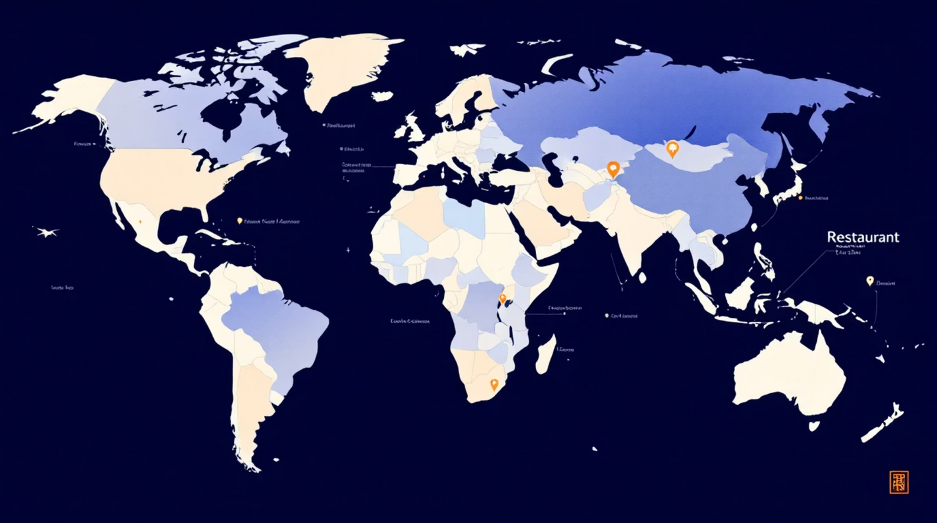
Project Description:
Why a Global Dataset?
A worldwide restaurant dataset was chosen to capture diverse environments, customer preferences, and pricing structures across different regions. This approach enables broader analysis of engagement patterns, rating reliability, cuisine demand, and service availability rather than limiting insights to a single location.
Using Power BI, the data was cleaned and visualized into interactive dashboards that highlight global performance trends and support data-driven decision-making across markets.
Notes:
3

Slide 4
Top Visualizations Used
The project primarily uses four impactful visualizations to communicate insights effectively:
• Scatter Chart — Used to analyze the relationship between customer votes and ratings, helping evaluate rating reliability.
• Column Chart — Enables clear comparison of restaurant performance across cuisines, cities, and operational categories.
• Line Chart — Highlights trends such as rating stability and engagement progression over vote ranges.
These visualizations were selected to represent relationships, comparisons, trends, and distributions in a clear and meaningful way.
Notes:
4

Slide 5





EXECUTION
Four-Phase Development Approach
The project was executed through structured in to 4 milestones to ensure systematic development from raw data preparation to strategic insights.
MILESTONE 1:Data Collection & Preprocessing
MILESTONE 2:Core Dashboard Development
Collected and cleaned restaurant dataset using Power Query. Handled missing values, standardized formats, and created derived columns for analysis.
Built initial dashboards analyzing customer engagement, ratings, cuisine popularity, pricing trends, and location-based patterns.
MILESTONE 3:Advanced Analytics
MILESTONE 4:Strategic Insights
Created sophisticated dashboards evaluating rating consistency and customer participation. Explored analytical relationships between votes and ratings.
Categorized restaurants into action-based groups: promotion, improvement, or monitoring. Converted findings into decision frameworks.
Notes:
5

Slide 6
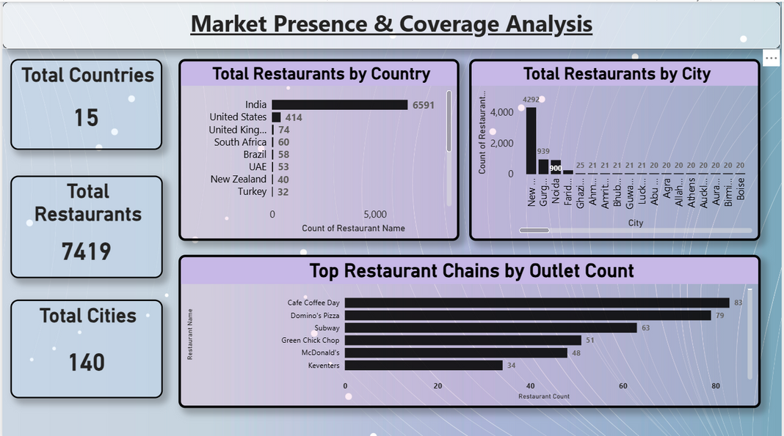
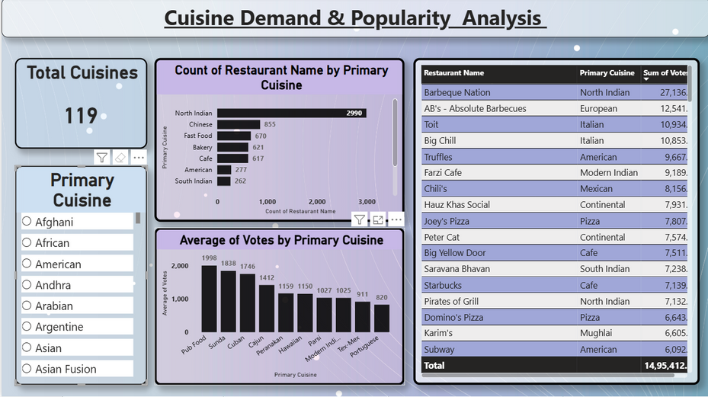
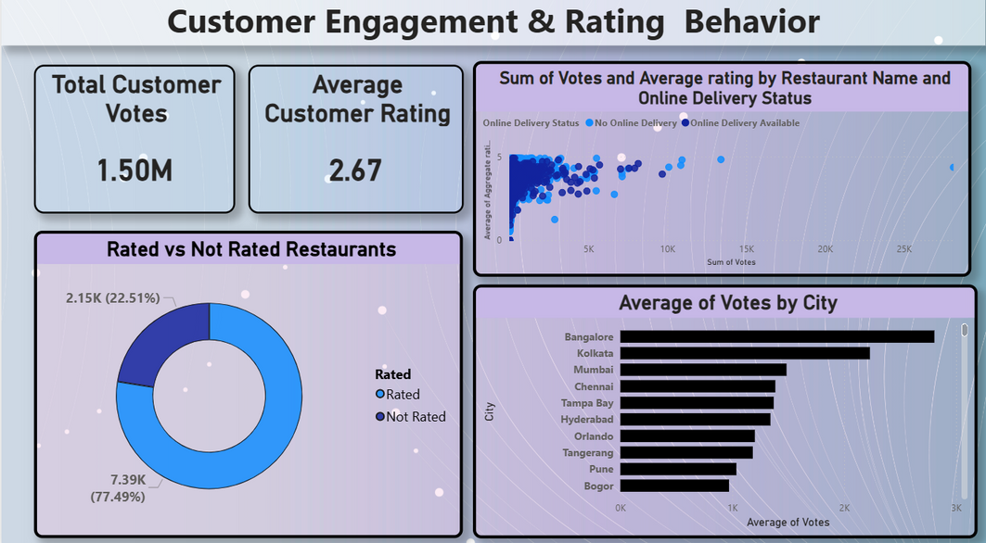
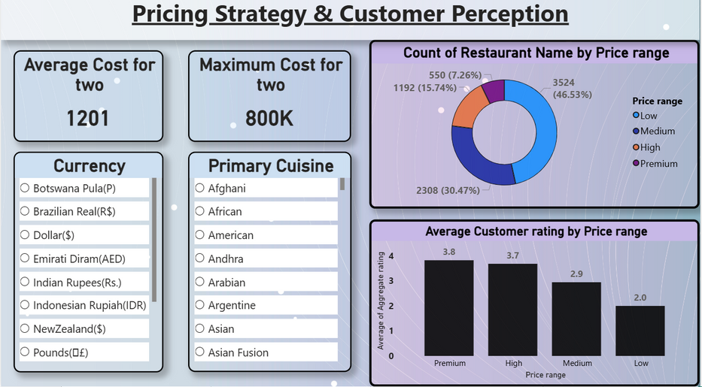
Dashboards
Notes:
6

Slide 7
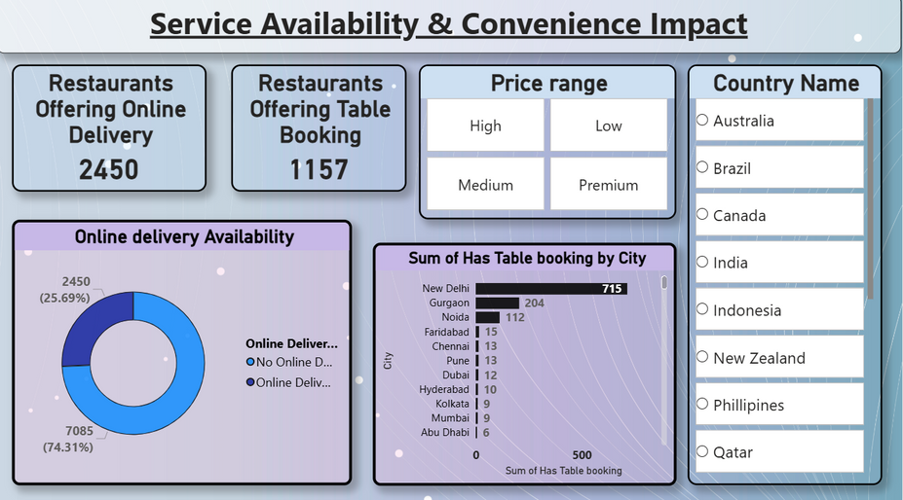
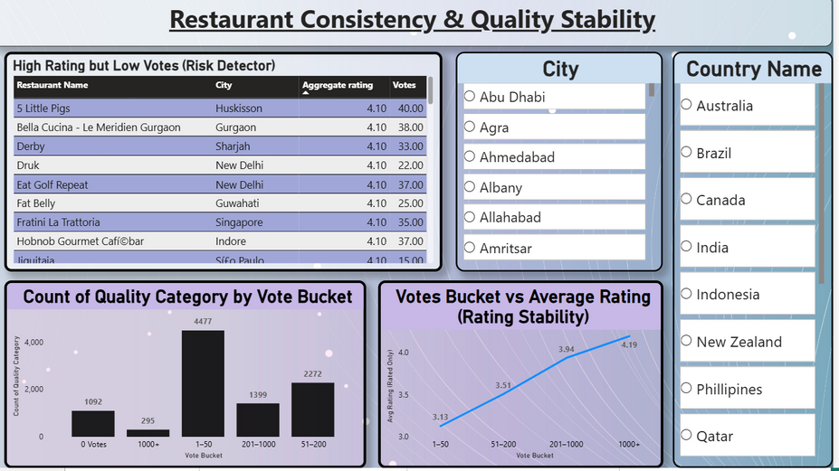
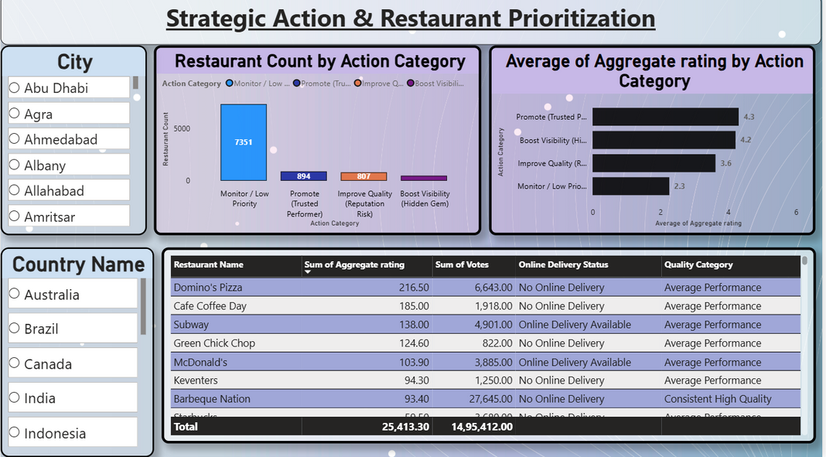
Dashboards
Notes:
6

Slide 8

Challenges And Resolution
Data Quality Issues
Power BI Complexity
Visualization Design
Handled incomplete and inconsistent data through careful cleaning and validation processes to ensure accurate analytical results.
Managed filter interactions and calculated measures, particularly when analyzing rating reliability and customer engagement patterns.
Selected appropriate visualizations to clearly represent complex relationships between votes, ratings, and performance metrics.
Overcoming these challenges improved analytical accuracy and strengthened dashboard usability, delivering more reliable insights.
Notes:
7

Slide 9

Skills Developed & Practical Outcomes
Technical Competencies Enhanced
Data preprocessing and quality management in Power BI
Dashboard development and visual storytelling
Analytical thinking and pattern recognition
Performance metric interpretation
Strategic Insights Gained
Strengthened understanding of how ratings, votes, pricing, and service features influence restaurant performance. Developed problem-solving skills and the ability to convert raw data into actionable insights for informed decision-making.
Notes:
8

Slide 10




Key Findings & Strategic Implications
Engagement Drives Reliability
Cuisine & Pricing Impact
Service Features Matter
Regional Variations
Significant performance differences across locations highlight the importance of regional analysis and localized strategies.
Restaurants with higher vote participation demonstrate more stable and trustworthy ratings, indicating quality consistency.
Customer interaction is significantly influenced by cuisine preferences and pricing strategies across different markets.
Online delivery and accessibility features improve customer engagement and expand market reach effectively.
Notes:
9

Slide 11


FUTURE VISION
Potential Enhancements & Next Steps
Real-Time Data Integration
Incorporate live data feeds to enable dynamic monitoring of restaurant performance and immediate trend detection.
Predictive Analytics
Forecast demand and trends
Predictive Analytics
Advanced Recommendations
Implement machine learning models to forecast customer behavior, rating trends, and demand patterns.
Real-time Integration
Ingest live data feeds
Deliver personalized actions
Strategic enhancements will transform this analytical foundation into a dynamic, predictive system.
Advanced Recommendations
Develop intelligent recommendation engines to improve decision-making and performance evaluation accuracy.
Notes:
10

Slide 12

Conclusion: Data-Driven Restaurant Intelligence
This project demonstrates how structured restaurant data can be transformed into meaningful insights through effective preprocessing and visualization. By analyzing customer engagement, ratings, cuisine trends, pricing, and service availability, the dashboards provide a comprehensive view of restaurant performance across global markets.
The integration of analytical logic with visualization supports data-driven decision-making and strategic prioritization. This work highlights the practical value of business intelligence in understanding real-world performance patterns and improving evaluation processes in the competitive restaurant industry.
Key Takeaway: Combining technical execution with strategic thinking creates actionable insights that drive meaningful business outcomes.
Notes:
11

Slide 13
Acknowledgement:
I would like to express our heartfelt gratitude to: Infosys Springboard Team– for organizing this valuable internship opportunity. Our Mentor– for her continuous support and feedback.
My Teammates – for collaboration, encouragement, and insights This internship has been a significant step in our professional growth and technical journey.
References:
Microsoft Power BI Documentation
Infosys Springboard Virtual Internship course materials
Notes:
12

Slide 14
THANK YOU
Notes:
13

